Slide 1
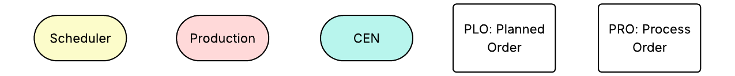
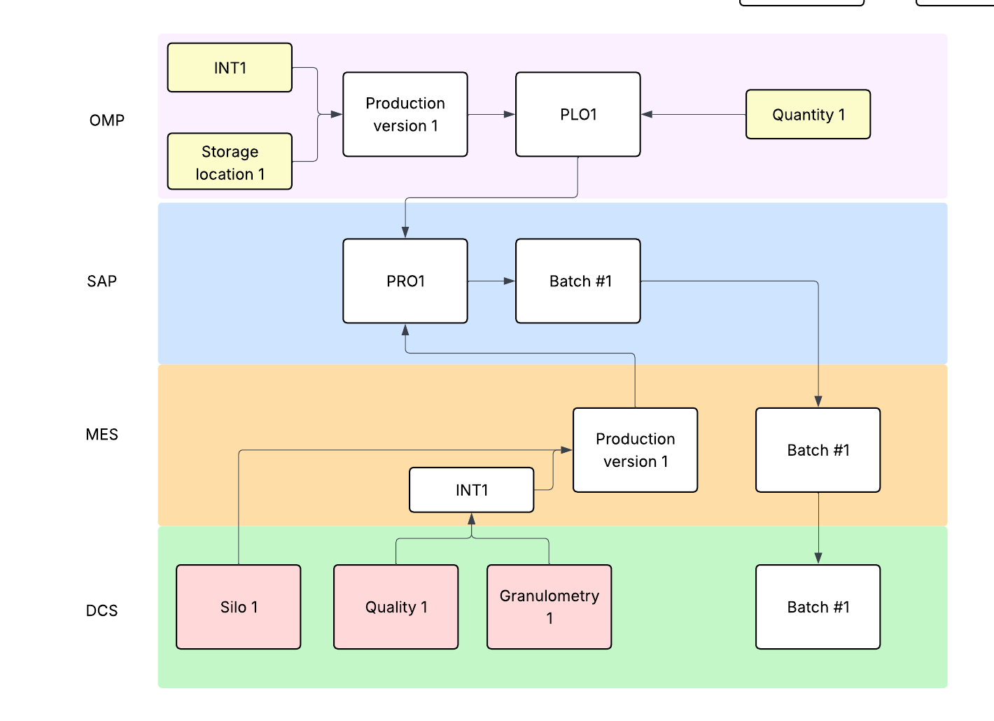
1.0 Ideal process – Scheduling and production

Slide 2
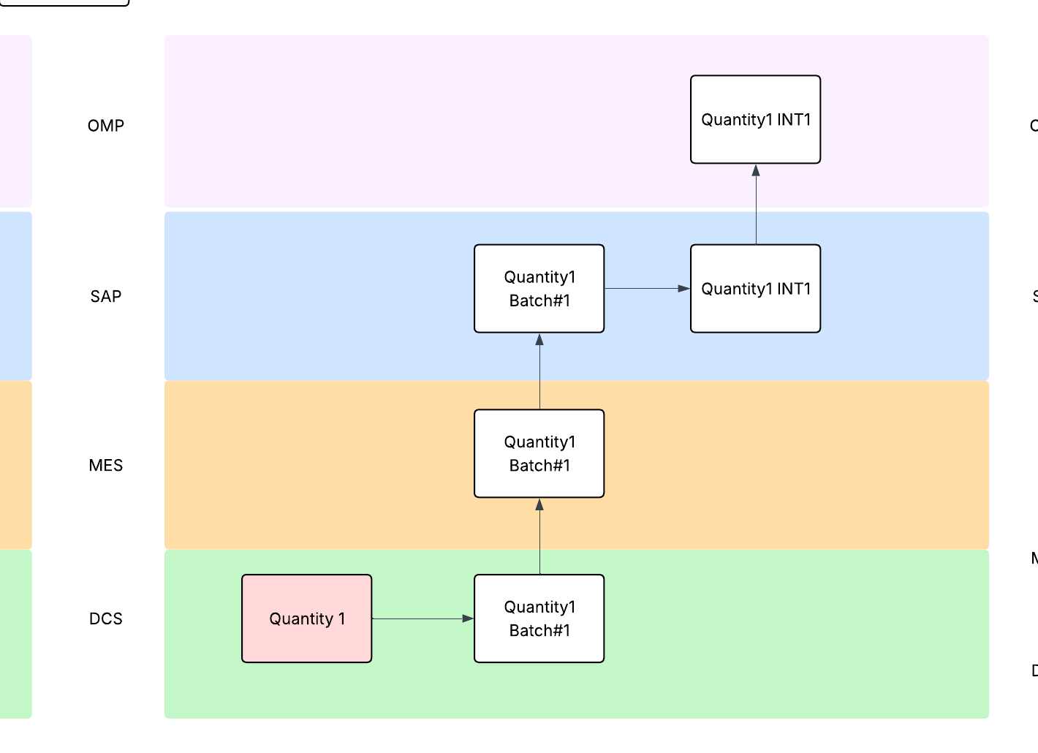
1.1 Ideal process – Bulk production declaration

Slide 3
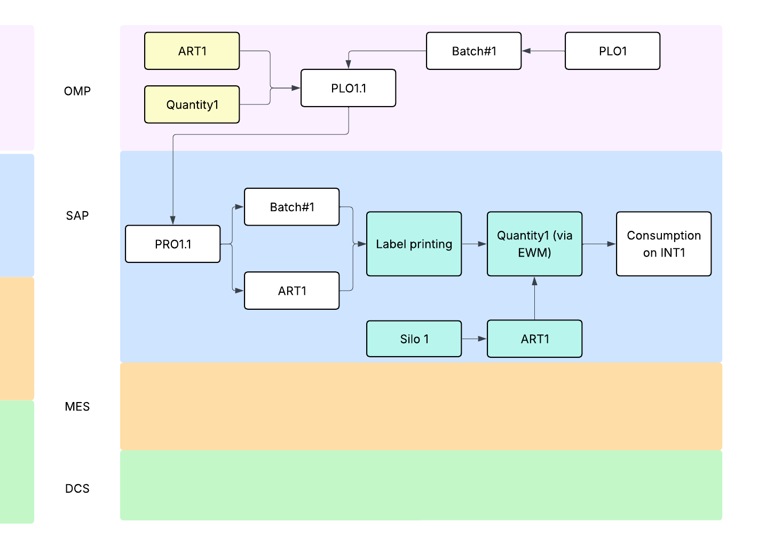
1.2 Ideal process – Packaging

Slide 4
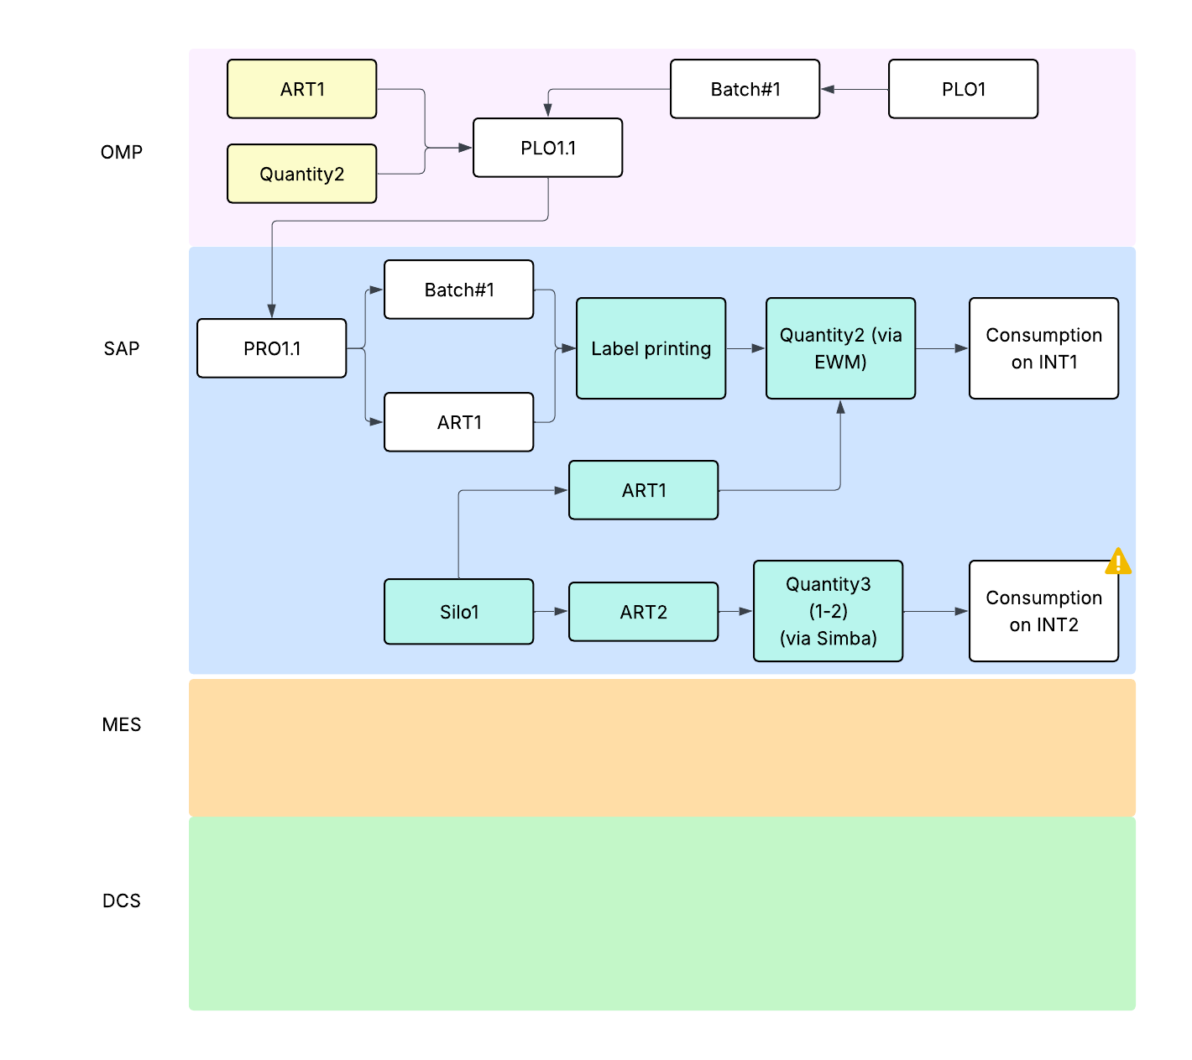
2.2 Partial downgrading of a silo after production – Packaging and loading
2.0 and 2.1 equal to 1.0 and 1.1

Slide 5

3.0 Full silo downgrading during production – Scheduling and production

Slide 6
3.1 Full silo downgrading during production – Production declaration
Same as 1.1 since we have a PRO where to declare production

Slide 7
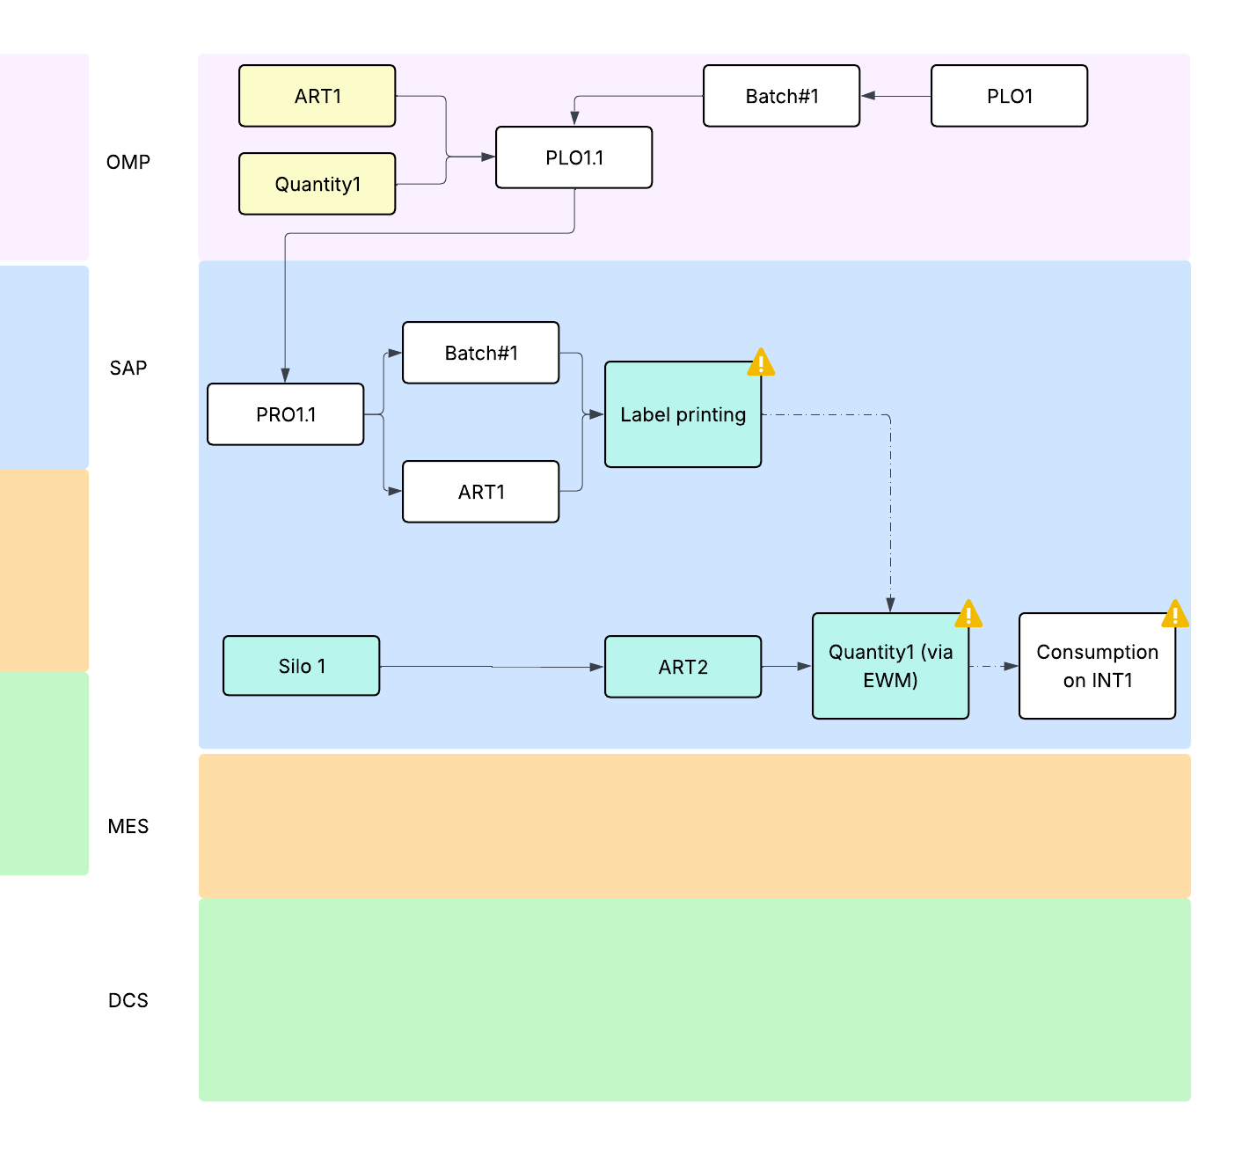
3.2 Full silo downgrading during production – Packaging

Slide 8
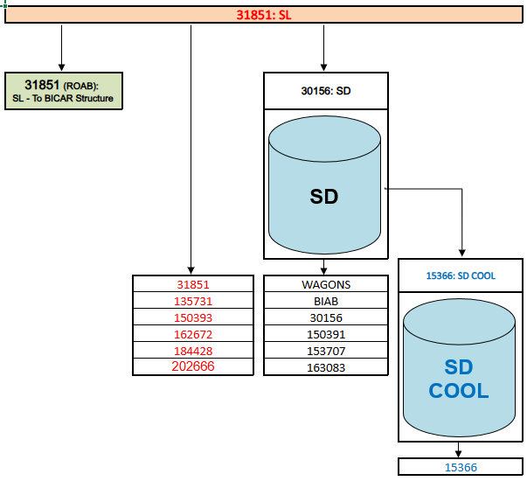
INT Structure - SODA ASH (to be reviewed since BIB, real INT, and SL have the same article)
Only 1 batch per time

Slide 9
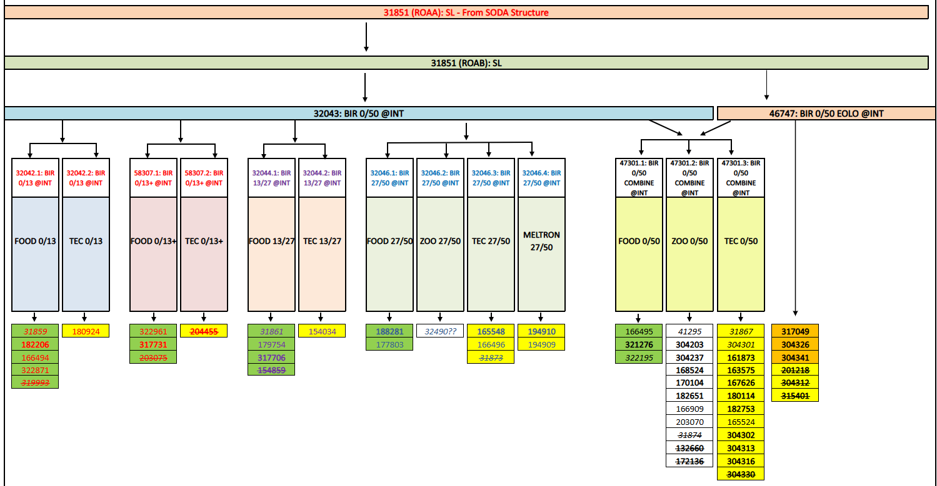
INT structure - BICAR
Max 12 simultaneous batches

Slide 10
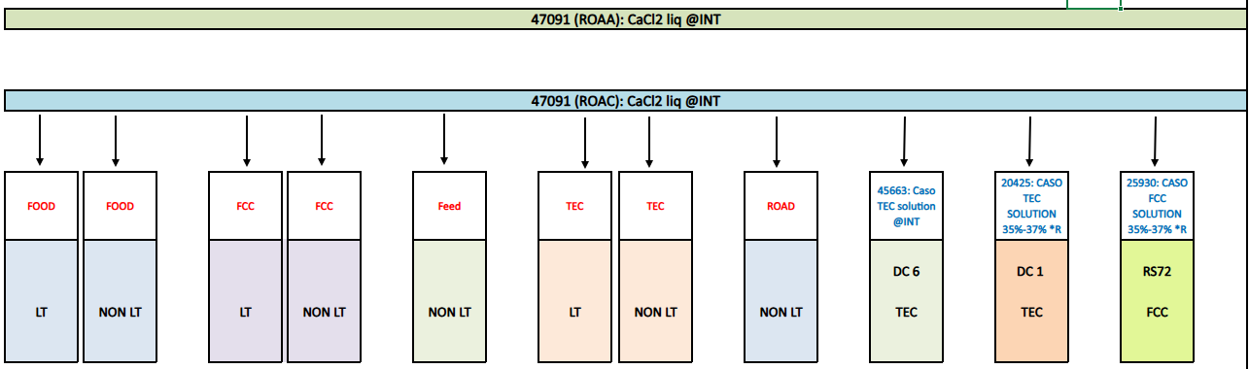
INT structure - CASO
Max 5 simultaneous batches

Slide 11
Open questions
The silos level will be on SAP? How frequent it will be updated?
How we will manage the filling/empting process?
Downgrading
  Full silo during production
  Last tons in the silo (normally sent to a truck)
What if we produce in a different day compared to the scheduled one? What happen to the batch created during scheduling and which batch # we will use for production declaration?
INT structure detail: what if we have to comunicate with production a specific INT product but the capability of the process is very low (high probability of downgrading)?

